Slide 1
Talent & Organization case study
By: Gaurav Shinde
Date: 22/01/2024

Slide 2
Business Objective
To identify complementarities & efficiency between business unit 1 & 2

Slide 3
Key data overview
Unit 1 | Unit 2
More senior employees – Age 50+ (8% ) | Less Senior employees – Age 50+ (1% )
Less promotion in FY ( 16% ) | More promotion in FY ( 31% )
Less involuntary exits ( 21% ) | More involuntary exits ( 69% )
Less high qualified employees MBA , PhD, JD ( 21.5%) | More high qualified employees MBA , PhD, JD (32%)
Senior at Career level 6 = 13% | Senior at Career level 6 = 4.5%
30% have completed more than 10 years of service | 18% have completed more than 10 years of service

Slide 4
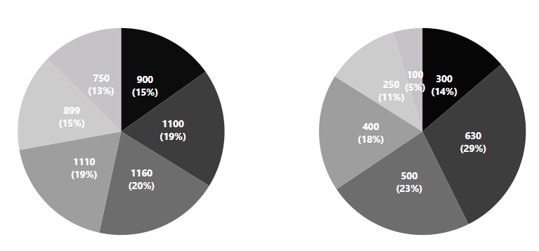
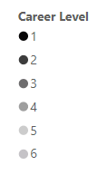
Insights : Career level
In Unit 1, there are more employees at the highest career level compared to Unit 2.
In Unit 1, 28% of workforce are at career levels 5 & 6, compared to 16% in Unit 2. In Unit 1, the workforce is well distributed throughout all levels, but in Unit 2, 34% of the employees are just starting their careers
Key takeaways:
Unit 1 exhibits a greater concentration of workers at the highest points of their careers, whereas Unit 2 primarily comprises workers at the beginning of their careers.

Slide 5
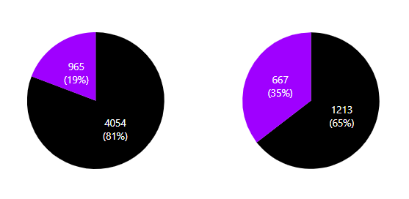

Insights : Promotion
Unit 1 has 965 (19%) promotions in FY whereas its almost double for Unit 2, 667 (35%) for active employees
In Unit 1, a higher percentage (6%) of early-career employees receive promotions, while in Unit 2, mid-career employees see a higher promotion rate (18%)
Key takeaways:
Unit 1 early career employees obtain promotions while mid level employees receive promotions in unit 2

Slide 6
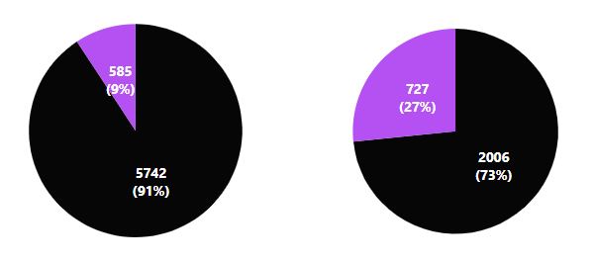

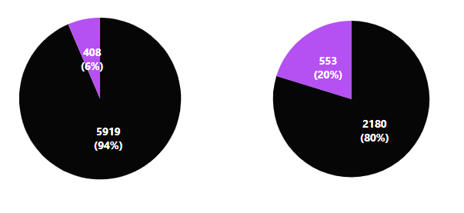

Insights : Hiring & Termination
In FY, Unit 1 hired 585 employees (9%), while Unit 2 hired 727 employees (27%).
Out of 585 hires in Unit 1, over 80% are at entry-level positions
Unit 1, termination : 6%
Unit 2, termination : 20%
In Unit 2, 70% involuntary exits, all with ratings below target
In Unit 1, the annual turnover rate is low at 6%, while Unit 2 high turnover of 34%

Slide 7
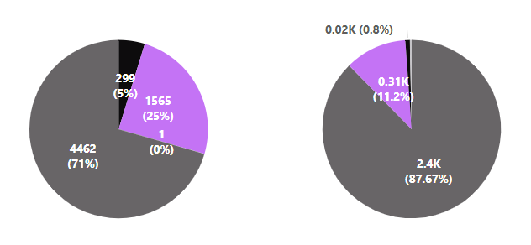
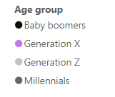
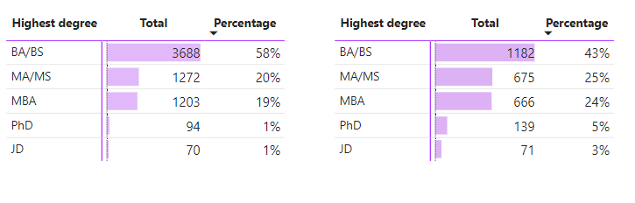
Insights : Age & Qualification
Unit 1
Unit 2
Unit 1: 8% seniors, 43% young
Unit 2: 1% seniors, 65% young
Unit 1: Nearly 30% ‘baby boomers’ and ‘generation X’
Unit 2: 88% Millennials
Unit 1
Unit 2
Unit 1: % of PhD , JD & MBA combined is 21%
Unit 2: 32%
Key takeaways:
Unit 1 has a higher proportion of seniors, but Unit 2 is dominated by a younger workforce.
Millennials make up a significant majority in Unit 2, while Unit 1 has a more balanced distribution of generations.
Unit 2 boasts a higher percentage of highly qualified individuals with advanced degrees.

Slide 8
Insights : Tenure & Period in job
Unit 1 | Unit 2
3.5% of employees have served for over 30 years | Only 0.1% have service tenure of over 30 years
27% have service tenure of over 10-20 years | 18% have a service tenure of 10-20 years
9% have a tenure of less than a year | 22% have a tenure of less than a year
Majority fall in the 5-10 years bucket | Majority fall in the 1-5 years bucket
Summary
Unit 1 reflects a seasoned and diverse workforce, showcasing loyalty and commitment over the years. In contrast, Unit 2 is characterized by a newer workforce, primarily in the early stages of their careers, with a strong emphasis on higher education

Slide 9




Key issues
Employee uncertainty & resistance
Senior employees are more resistant to change, especially if they are accustomed to traditional methods & processes
Talent Retention & high attrition
Inexperienced employees expect quick career advancement. Unmet expectations may cause dissatisfaction and high turnover. Retaining talent requires ample growth opportunities
Cultural misalignment
Older employees value loyalty, stability, and a strong work ethic, while younger employees prioritize flexibility, work-life balance, and purpose. These differing values can lead to conflicts
Communication
Effective teamwork requires bridging the communication gap between younger employees favoring digital methods and older employees preferring traditional forms.

Slide 10



Recommendations
Foster cross-generational collaboration between business units for a more diverse and harmonious workplace. Encouraging knowledge-sharing among different age groups leverages unique strengths, fostering culture that addresses cultural misalignment & benefits the entire company
Establish mentorship programs where experienced employees can guide and share their knowledge with less experienced colleagues. This promotes a supportive learning environment
Diversity & Inclusion initiatives Recognize and appreciate the unique contributions that both experienced and less experienced employees bring to the organization. This helps build a positive and inclusive work environment

Slide 11


Recommendations (Contd.)
To implement organization wide talent development programs to bridge skill gaps, enhance qualifications, and prepare employees for career advancement in both the units to reduce the turnover rate.
Current disparity in promotions within two business units. Implement fair parameters for assessing employee performance, create a more equitable promotion process, fostering a culture of meritocracy & ensuring opportunities are distributed fairly among all deserving individuals
Foster a culture that values continuous learning & adaptation. Encourage all employees from both units, regardless of experience level , age or education , to stay updated on industry trends and embrace a mindset of lifelong learning

Slide 12



Conclusion
The comprehensive analysis of data from Unit 1 & Unit 2 strongly supports the recommendation to merge the two business units. This strategic alignment is poised to capitalize on the complementary strengths of each unit.
To ensure the success of this merger, diligent adherence to the outlined recommendations is crucial
Post-merger, the establishment & vigilant monitoring of key performance indicators (KPIs) will be vital in tracking & optimizing the overall performance of the integrated business unit, ensuring a seamless transition & sustained success

Slide 13

Thank you!

